Slide 1
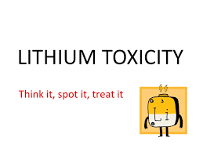
Lithium Toxicity
Presented by Mera Gergis
Under Supervision of Dr/ Rania Radwan

Slide 2
Objectives:
Introduction & Background
Mechanism of action
Pathophysiology
Pharmacokinetics & Dynamics
Adverse Effects
Features of Lithium Toxicity
Investigations
Management of lithium toxicity
Case study

Slide 3
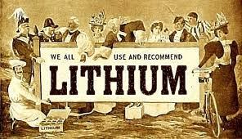
Introduction:-
Lithium has been used in medicine since the 1870s. Lithium was initially used to treat depression, gout, and neutropenia, and for cluster headache prophylaxis, but it fell out of favor because of its side effects.
The US Food and Drug Administration (FDA) banned the use of lithium in the 1940s because of fatalities but lifted the ban in 1970

Slide 4
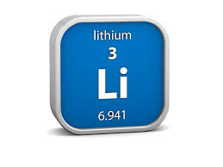
More about lithium:
Lithium (from Greek lithos 'stone') is a chemical element with symbol Li and atomic number 3. It is a soft, silver-white metal belonging to the alkali metal group of chemical elements. Under standard conditions it is the lightest metal and the least dense solid element. Like all alkali metals, lithium is highly reactive and flammable. For this reason, it is typically stored in mineral oil.

Slide 5
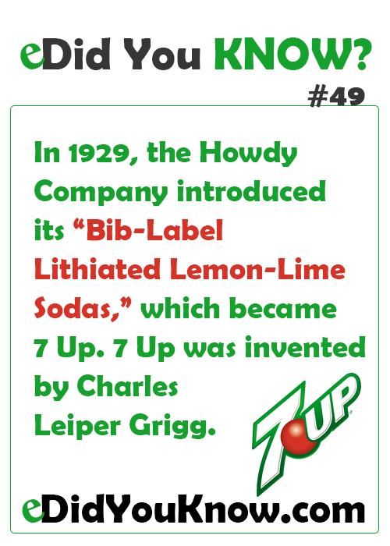
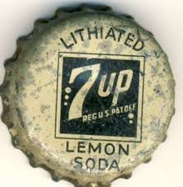


Slide 6
Background
Lithium is commonly used as maintenance treatment of bipolar disorder.
It has a relatively narrow therapeutic index that predisposes patients on lithium maintenance treatment to poisoning with relatively minor changes in medications or health status.
Clinically, the three main categories of lithium poisoning are as follows:
Acute – predominantly gastrointestinal (GI)
Acute-on-chronic – Both GI and neurologic manifestations may be present
Chronic – Manifestations are primarily neurologic

Slide 7
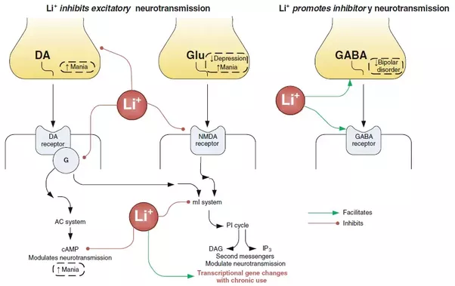
Mechanism of action

Slide 8
Pathophysiology:
Target Organs:
(CNS) is the major organ system affected, although the renal, gastrointestinal (GI), endocrine, and cardiovascular (CV) systems also may be involved.
Format :
Only Oral Form.
Absorption:
- Completely absorbed from GIT.
- Peak levels occur 2-4 hours postingestion, although absorption can be much slower in massive overdose or with ingestion of sustained-release preparations

Slide 9
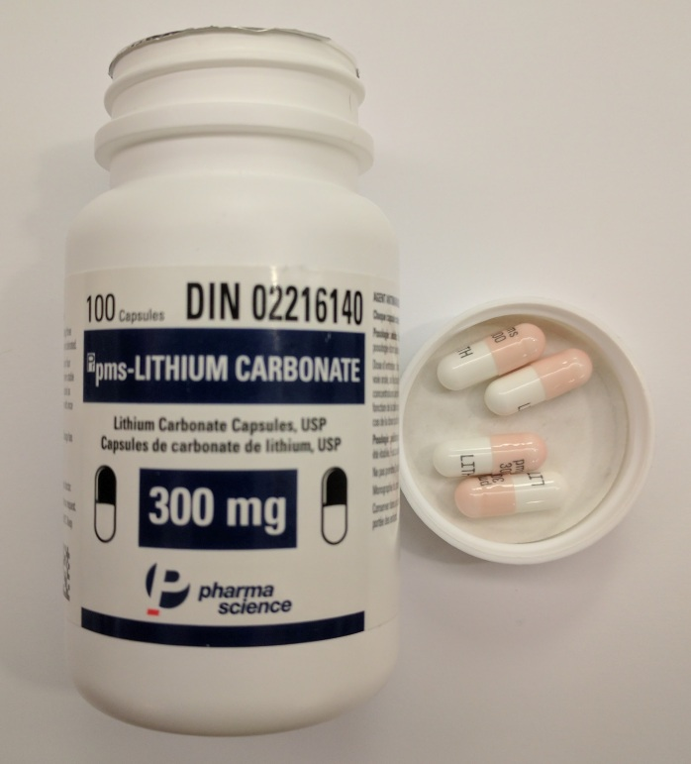
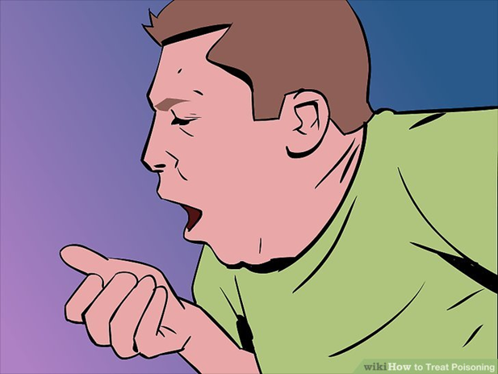
Pharmacokinetics and Pharmacodynamics
Transport :
Lithium is minimally protein bound (< 10%)
Dose:
The therapeutic dose is 300-2700 mg/d with desired serum levels of 0.6-1.2 mEq/L.
Tablets : 150 mg 300 mg 600mg

Slide 10
Clearance:
Predominantly through the kidneys.
Consequently, dosing must be adjusted on the basis of renal function. Individuals with chronic renal insufficiency must be closely monitored if placed on lithium therapy.
Reabsorption:
Most filtered lithium is reabsorbed in the proximal tubule
Half-life:
The plasma elimination half-life of a single dose of lithium is from 12-27 hours (varies with age). The half-life increases to approximately 36 hours in elderly persons (secondary to decreased GFR).

Slide 11
Interactions:
The following three major drug classes have been identified as potential precipitants of lithium toxicity:
Diuretics that promote renal sodium wasting
ACEI that reduce (GFR) & enhance tubular lithium reabsorption
NSAIDs that reduce the (GFR) and interrupt of renal PGs synthesis.
Others:
Drugs known to inhibit proximal tubular reabsorption, such as carbonic anhydrase inhibitors and aminophylline, may increase excretion.

Slide 12
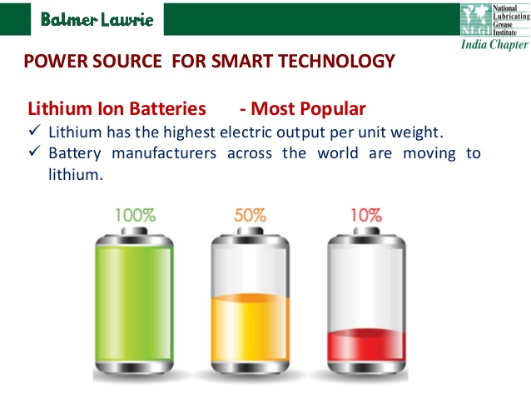
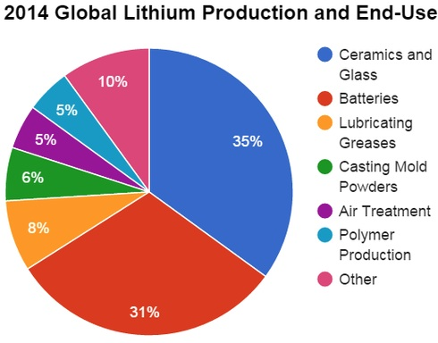
Uses of Lithium:
:FDA approved indications
Bipolar disorder , manic episode
Non-FDA approved (off-label indications): !!!
Cluster headache
SIADH
Neutropenia
Gout
Grave`s disease

Slide 13

Adverse effects:
Goiter In 40 %, may lead to hypothyroidism in 20 %
2) Polyuria (secondary to nephrogenic diabetes insipidus)
3) Anorexia/Nausea/Vomiting, Diarrhoea
Fine tremor in chronic treatment, coarse tremors in acute ttt
ECG: T wave flattening/inversion
6) Weight gain
Hypercalcaemia (Raise ↑ serum Ca)
Hypermagnesaemia (Raise ↑ serum Mg)
Hyperprolactinaemia (due to Hypothyroidism) causing infertility

Slide 14
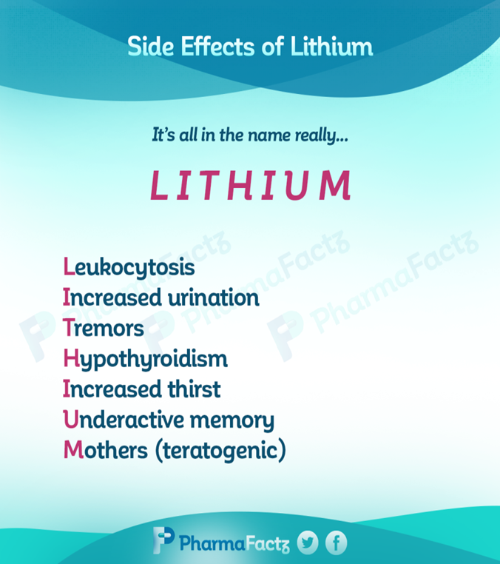
N.B :
Fine tremor in chronic treatment Coarse tremor in acute toxicity.
The common clinical side effects of the lithium are Goitre in up to 40% and hypothyroidism in about 20%. Lithium increases thyroid autoimmunity if present before therapy. Treatment with levothyroxine is effective and lithium therapy should not be stopped.

Slide 15
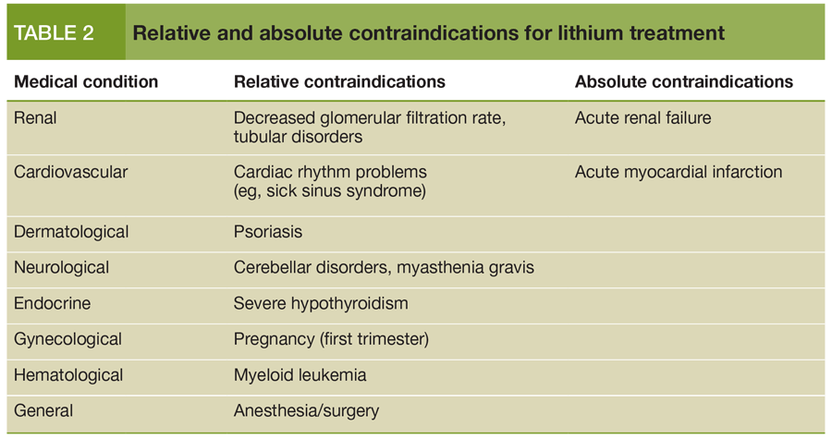
Contraindications:

Slide 16
Monitoring of lithium therapy:
Levels should be taken 12 hours post-dose.
Normal level 0.5-1 mmol/L
Thyroid and renal function should be checked every 6 months.
GGT is the most sensitive measure of the effects of lithium on the liver.

Slide 17
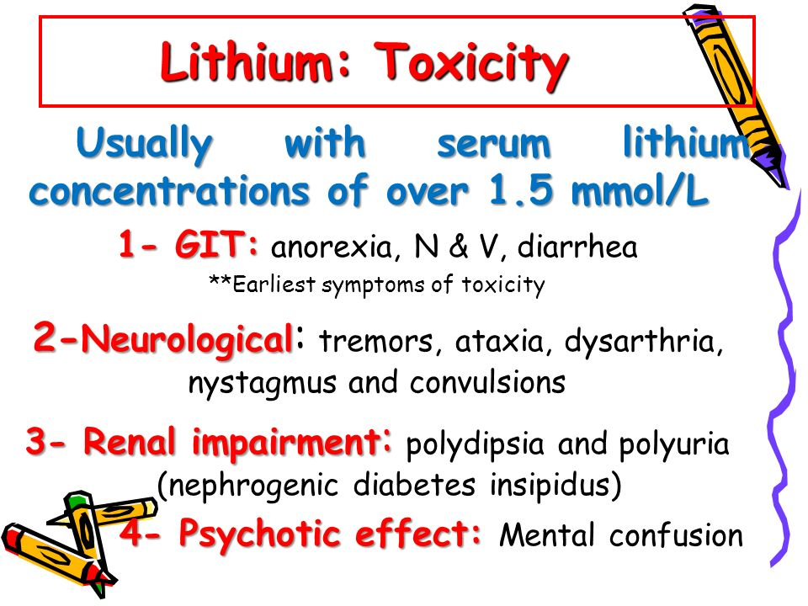
Lithium toxicity
Lithium toxicity generally occurs following concentrations > 1.5 mmol/L. Toxicity may be precipitated by:
1) Dehydration
2) Diuretics (especially Thiazide & furosemide )
3)Renal failure

Slide 18
4) NSAIDs
5) ACEI & ARBs.
6) CCB (Verapamil & Diltiazem).
7) Metronidazole is the only antibiotic listed in the BNF that may interact with lithium.
BNF advises that neurotoxicity may be ↑ when lithium is given with diltiazem or verapamil but there is no significant interaction with amlodipine.
Atenolol, in contrast, is a relatively safer option for the treatment of hypertension in association with long term lithium use. Alpha-blockers would not be first line treatment for hypertension.

Slide 19
Features of toxicity:
Three main categories of lithium poisoning are as follows: acute, acute-on-chronic, and chronic.
Acute poisoning
Mainly Gastrointestinal (GI), including nausea, vomiting, cramping, and sometimes diarrhea.
Progression of acute toxicity can involve neuromuscular signs such as tremulousness, dystonia, hyperreflexia, and ataxia.
Cardiac dysrhythmias rarely occur. The most common electrocardiographic finding is T-wave flattening.

Slide 20
Acute-on-chronic poisoning
These patients take lithium regularly and have taken a larger dose recently.
These patients may display both GI and neurologic symptoms,
Serum levels can be difficult to interpret.
Patients should be treated according to their clinical manifestations.

Slide 21
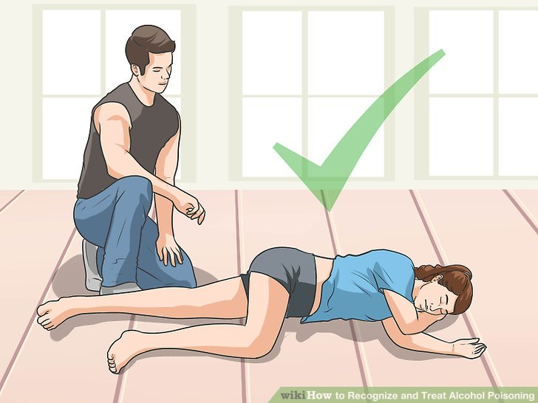
Chronic poisoning
Chronic lithium toxicity is usually precipitated with introduction of a new medication that may impair renal function/excretion or cause a hypovolemic state.
Symptoms are primarily neurologic.
Mental status is often altered and can progress to coma and seizures if the diagnosis is unrecognized.

Slide 22
SILENT syndrome
Many severely poisoned patients can develop a syndrome of irreversible lithium-effectuated neurotoxicity (SILENT) such as cognitive impairment, sensorimotor peripheral neuropathy, and cerebellar dysfunction.

Slide 23
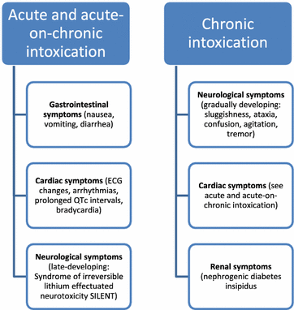

Slide 24
Physical effects
Neurologic effects :
Coarse Tremors (a fine tremor is seen in therapeutic levels)
Lethargy
Confusion
Altered mental status
Hyperreflexia
Seizures
Coma

Slide 25
Gastrointestinal effects :
Nausea
Vomiting
Crampy abdominal pain
Diarrhea
Cardiovascular effects :
Hypotension
Bradycardia
Heart block

Slide 26
Systemic effects
Renal toxicity in chronic lithium therapy
Nephrogenic diabetes insipidus >>the most severe manifestation.
(Lithium inhibits the action of (ADH) on the distal renal tubule, impairing sodium and water reabsorption.
Renal tubular acidosis
Chronic tubulointerstitial nephritis and Nephrotic syndrome

Slide 27
Hypothyroidism >>>Myxedema coma has been reported as a complication of toxicity.
Acute exposure to lithium can cause leukocytosis, whereas Chronic exposure can produce aplastic anemia.

Slide 28
Laboratory studies:
Lithium Level : However, levels may not correlate with clinical symptoms. Serial levels may be warranted in cases of sustained-release tablets.
Urinalysis, electrolyte levels, and renal function
A low anion gap or a low urine specific gravity may suggest lithium toxicity due to sodium loss.

Slide 29
Thyroid function test >> considered in patients presenting with symptoms suggestive of hypothyroidism.
Co-ingestants should also be considered in cases of intentional overdose. An acetaminophen level should be obtained in every patient suspected of intentional overdose.
Lumbar puncture should be considered in patients with altered mental status and suspicion of central nervous system infection.

Slide 30
Imaging studies:
Computed tomography scan (CT) of the head in individuals with severe movement disorders, seizures, stupor, or coma to rule out other etiologies
ECG:
Chronic lithium toxicity is frequently associated with nonspecific and diffuse depressed ST segments and T-wave inversion
Dysrhythmias, including complete heart block.
Serious cardiac toxicity is uncommon and generally only occurs in individuals with underlying heart disease.

Slide 31
Management:
Pre-hospital care
Emergency medical services (EMS) personnel should do the following:
• Stabilize life-threatening conditions and initiate supportive therapy according to local EMS protocols.
• Obtain intravenous access with isotonic sodium chloride solution.
• Monitor cardiac function to assess rhythm disturbances.
• Obtain all pill bottles available to the patient.

Slide 32
Emergency Department Care
Supportive therapy is the mainstay of treatment of lithium toxicity.
volume resuscitation with normal saline.
Airway protection is crucial due to emesis and risk of aspiration.
Seizures can be controlled with benzodiazepines, phenobarbital, or propofol.

Slide 33
GI Decontamination
Gastric lavage may be attempted if the patient presents within one hour of ingestion.
Activated charcoal has no role. However, activated charcoal might be considered in the case of exposure to co-ingestants.
Whole-bowel irrigation with polyethylene glycol lavage can be effective in preventing absorption from extended-release lithium.
Because of its similarity to potassium, the use of sodium polystyrene sulfonate has been proposed as a method of eliminating lithium.

Slide 34
Enhanced Elimination
The mainstay of treatment is fluid therapy. The goal of saline administration is to restore glomerular filtration rate (GFR), normalize urine output, and enhance lithium clearance.

Slide 35
Hemodialysis is indicated for :
patients who have renal failure.
patients who cannot tolerate hydration, such as those with congestive heart failure (CHF) or liver disease
patients who develop severe signs of neurotoxicity, such as profound altered mental status and seizures.

Slide 36
5) An absolute level of 4 mEq/L in acute toxicity and a level of 2.5 mEq/L in chronic toxicity in patients with symptoms.
Because postdialysis rebound elevations in lithium levels have been documented, continuous venovenous hemofiltration (CVVH) has been advocated
Patients who are already on peritoneal dialysis should continue with it while awaiting hemodialysis or CVVH.

Slide 37
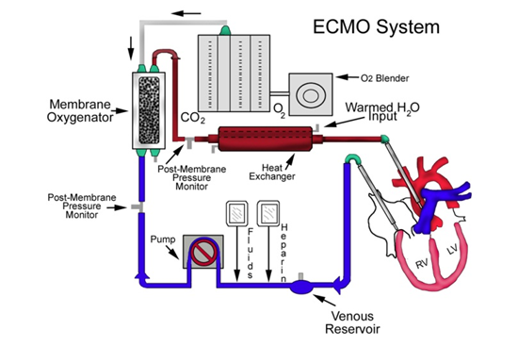
ECMO

Slide 38
Extracorporeal membrane oxygenation (ECMO), also known as extracorporeal life support (ECLS), is an extracorporeal technique of providing prolonged cardiac and respiratory support to persons whose heart and lungs are unable to provide an adequate amount of gas exchange or perfusion to sustain life. The technology for ECMO is largely derived from cardiopulmonary bypass, which provides shorter-term support.
.

Slide 39
This intervention has mostly been used on children, but it is seeing more use in adults with cardiac and respiratory failure.
ECMO works by removing blood from the person's body and artificially removing the carbon dioxide and oxygenating red blood cells Generally, it is used either post-cardiopulmonary bypass or in late stage treatment of a person with profound heart and/or lung failure, although it is now seeing use as a treatment for cardiac arrest in certain centers, allowing for treatment of the underlying cause of arrest while circulation and oxygenation are supported

Slide 40
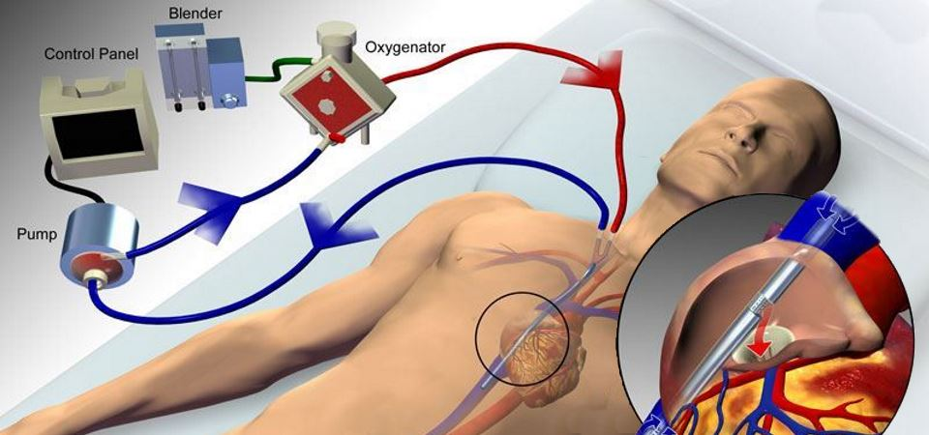
Types
The two most common of which are the veno-arterial (VA) and veno-venous (VV). In both modalities, blood drained from the venous system is oxygenated outside of the body. In VA ECMO, this blood is returned to the arterial system and in VV ECMO the blood is returned to the venous system. In VV ECMO, no cardiac support is provided.

Slide 41
Extracorporeal treatment in severe lithium poisoning in patients with the following :
• Impaired kidney function and lithium levels >4.0 mEq/L
• Decreased consciousness, seizures, or life- threatening dysrhythmias, regardless of lithium levels
• Levels are >5.0 mEq/L, significant confusion is noted, or the expected time to reduce levels to <1.0 mEq/L is more than 36 hours.

Slide 42
Extracorporeal treatment should be continued until clinical improvement is seen or levels fall to <1.0 mEq/L. If levels are not readily measurable, extracorporeal treatments should be continued for a minimum of 6 hours.

Slide 43
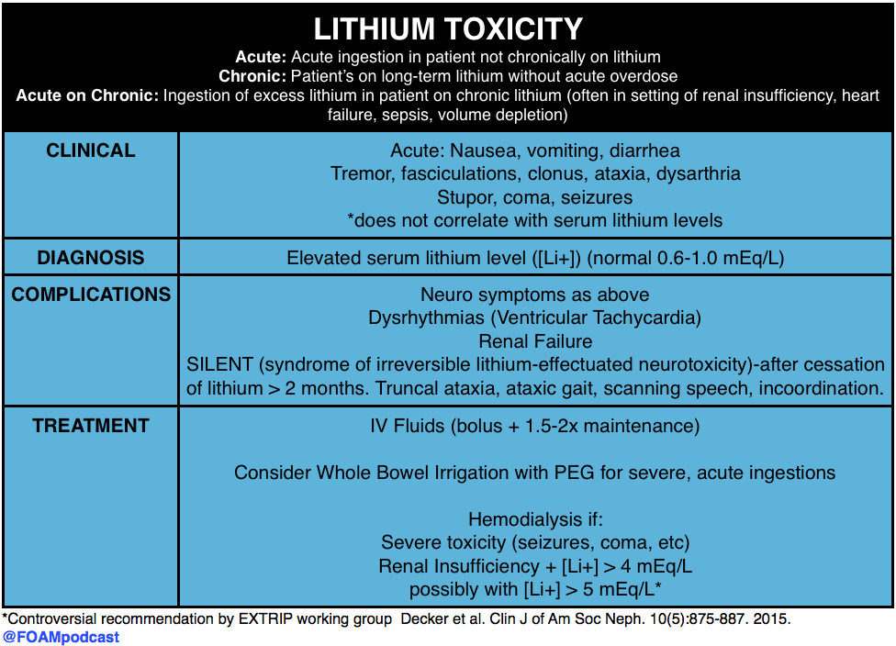
Summary:

Slide 44
Case Study

Slide 45
A case of 66 years old female patient, suffering bipolar disorder was admitted at the gerontopsychiatric department due to a confusional state, tremor and gait abnormality.
At the admission the patient appeared confused, complaining of nausea, weakness, unstable gait, memory difficulties and severe anxiety.
On physical examination - reduced body mass, afebrile, pale dry skin.
Lung & Cardiac exam were Normal. BP : 125/85 mm/Hg, P70; ECG was normal, Abdomen was insensitive.
Neurological exam revealed coarse tremor of body and hands, gait ataxia. Hand tremor increased under pressure. Mental status at the time of assessment- the patient was anxious, agitated and pacing during the interview. Though oriented to place and person, she looked confused with difficulty focusing and sustaining attention and short-term memory difficulties.
Notes:
Our case highlights few important points. Lithium has a relatively narrow therapeutic index that predisposes patients, especially older ones, on chronic maintenance treatment to lithium intoxication and neurotoxicity at serum levels which are considered “therapeutic” in younger adults. There is also a difference in lithium tolerability with age, and the prevalence of hand tremor with lithium increases with age [5, 15]. The dosage and serum concentrations of lithium need to be much reduced in the elderly population. Older patients require a dose 31% lower than those aged

Slide 46
Lithium toxicity was suspected when sufficient information about previous medical history of lithium therapy has been obtained.
Lithium level found to be 1.69 mmol/L. The patient had been on maintenance therapy with a lithium carbonate dosage 450 mg twice daily, which had been unchanged for months. Plasma levels of Lithium were not examined regularly. Drug history included Lisinopril , Torvalipin (Atorvastatin), Moxotens (Moxonidine), Furanthril (Furosemide). Laboratory values of hematology and biochemistry, including creatinine, were normal.
CT scan of the head ruled out other etiologies. Although the plasma value of Lithium was comparatively mildly elevated, neurotoxicity was produced, leading to severe neurological symptoms.
The patient was commenced on IV fluid hydration with isotonic Sodium chloride solution 1000 ml/daily and Mannitol 250 ml in-between for 7 days. Lisinopril and Furanthril were discontinued. Lithium levels decreased to 0.39 mmol/L. After 20 days the patient was discharged in a stable general and psychic state.

Slide 47
References
Greller HA. Lithium. In: Hoffman RS, Howland MA, Lewin NA, Nelson LS, Goldfrank LR, eds. Goldfrank's Toxicologic Emergencies. 10th ed. New York: McGraw-Hill Education; 2015.
Mowry JB, Spyker DA, Brooks DE, Zimmerman A, Schauben JL. 2015 Annual Report of the American Association of Poison Control Centers' National Poison Data System (NPDS): 33rd Annual Report. Clin Toxicol (Phila). 2016 Dec. 54 (10):924-1109. [Medline]. [Full Text].
National Poison Data System Annual Reports. American Association of Poison Control Centers. Available at http://www.aapcc.org/annual-reports/. Accessed: January 21, 2017.
Ng YW, Tiu SC, Choi KL, Chan FK, Choi CH, Kong PS. Use of lithium in the treatment of thyrotoxicosis. Hong Kong Med J. 2006 Aug. 12(4):254-9. [Medline].
Lee DC, Klachko MN. Falsely elevated lithium levels in plasma samples obtained in lithium containing tubes. J Toxicol Clin Toxicol. 1996. 34(4):467-9. [Medline].
Hsu CH, Liu PY, Chen JH, Yeh TL, Tsai HY, Lin LJ. Electrocardiographic abnormalities as predictors for over-range lithium levels. Cardiology. 2005. 103(2):101-6. [Medline].

Slide 48
Linakis JG, Savitt DL, Wu TY, Lockhart GR, Lacouture PG. Use of sodium polystyrene sulfonate for reduction of plasma lithium concentrations after chronic lithium dosing in mice. J Toxicol Clin Toxicol. 1998. 36(4):309-13. [Medline].
Ghannoum M, Lavergne V, Yue CS, Ayoub P, Perreault MM, Roy L. Successful treatment of lithium toxicity with sodium polystyrene sulfonate: a retrospective cohort study. Clin Toxicol (Phila). 2010 Jan. 48(1):34-41. [Medline].
Bretaudeau Deguigne M, Hamel JF, Boels D, Harry P. Lithium poisoning: the value of early digestive tract decontamination. Clin Toxicol (Phila). 2013 May. 51(4):243-8. [Medline].
Decker BS, Goldfarb DS, Dargan PI, Friesen M, Gosselin S, Hoffman RS, et al. Extracorporeal Treatment for Lithium Poisoning: Systematic Review and Recommendations from the EXTRIP Workgroup. Clin J Am Soc Nephrol. 2015 Jan 12. [Medline].
Menghini VV, Albright RC Jr. Treatment of lithium intoxication with continuous venovenous hemodiafiltration. Am J Kidney Dis. 2000 Sep. 36(3):E21. [Medline].
van Bommel EF, Kalmeijer MD, Ponssen HH. Treatment of life-threatening lithium toxicity with high-volume continuous venovenous hemofiltration. Am J Nephrol. 2000 Sep-Oct. 20(5):408-11. [Medline].

Slide 49
Thank You

